Slide 1
Predicting Antiviral Drugs over COVID-19 Knowledge Graph
Changlong Yu, Tianqing Fang
cyuaq@connect.ust.hk, tfangaa@connect.ust.hk

Slide 2
Table of Content
Introduction
Machine Learning on COVID-19 Knowledge Graph
Knowledge Graph Embedding
Methodologies
Knowledge Graph Embedding
Node Classification
Experiments
Results and Analysis
Link Prediction Results
Node Classification Analysis
Conclusions

Slide 3
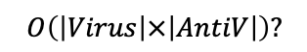
Introduction
Research and Development of COVID-19 Antiviral Drugs
RNA virus that parasitizes in the host and replicates itself.
Antiviral Drugs can target a certain link of virus replication.
Extensive biological experiments are needed to determine the virus suppression effects.
DNA
RNA
Protein
$$O\left(\left|Virus\right|×\left|AntiV\right|\right)?$$
Transcription
Translation
Relation 1: genetic material and protein
Antiviral Drug
Virus
Suppress
Relation 2: Certain drugs suppress certain virus
Figure 1: Illustration of the SARS-CoV-2 virion
Figure 2: Examples of relationships between biological entities.

Slide 4
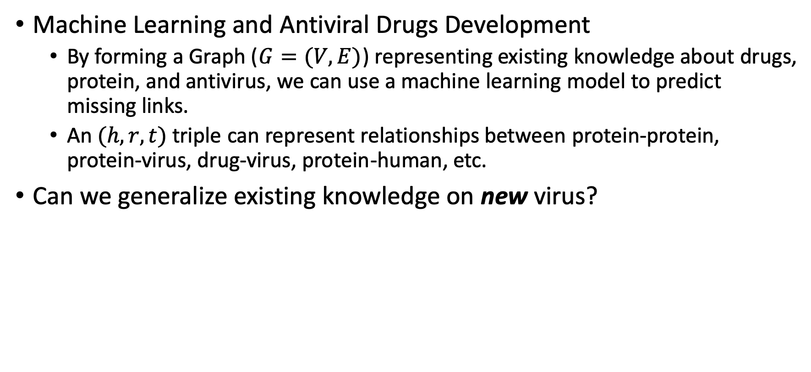
Introduction
Machine Learning and Antiviral Drugs Development
By forming a Graph ($G=(V, E)$) representing existing knowledge about drugs, protein, and antivirus, we can use a machine learning model to predict missing links.
An $(h, r, t)$triple can represent relationships between protein-protein, protein-virus, drug-virus, protein-human, etc.
Can we generalize existing knowledge on new virus?
Notes:
For example, if we know some specific drugs can be effective for the virus that produces certain protein types. Can we generalize this knowledge to new virus that produces similar protein?

Slide 5
Introduction
A real example regarding HIV.
Investigate Drug-Virus, Protein-human/virus.
ITA4
Ritonavir
Host Protein
Virus
Do drugs that work on virus that produces certain protein also work on new virus that produces certain protein?
TOR1A
NP
Effect
Effect
Indianavir
Host
Belong_to
Produce
Virus Protein
Belong_to
Binding
Drug
Interaction
Belong_to
Effect
Interaction
HIV
DJB11
Dolutegravir
Interaction
Effect
Knowledge Graph Embedding!
Interaction
Interaction
ENV
Lopinavir
PB2
HEMA

Slide 6
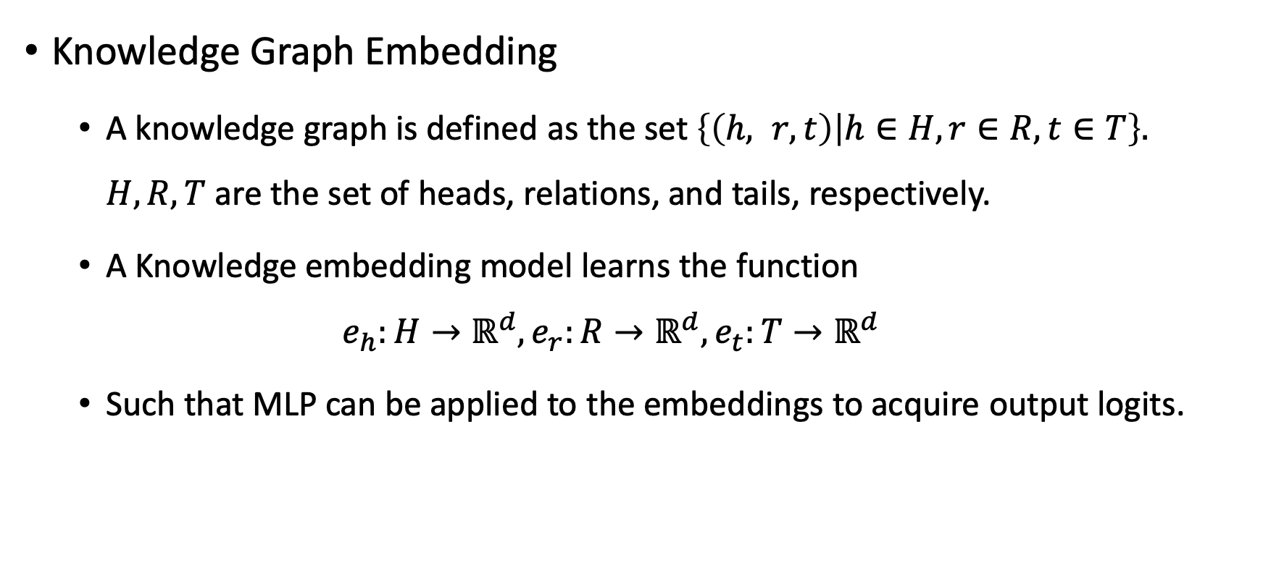
Introduction
Knowledge Graph Embedding
A knowledge graph is defined as the set $\left\{\left(h, r, t\right) | h∈H,r∈R, t∈T\right\}.$ $H, R, T$ are the set of heads, relations, and tails, respectively.
A Knowledge embedding model learns the function
$$e_{h}:H→ℝ^{d}, e_{r}:R→ℝ^{d}, e_{t}:T→ℝ^{d}$$
Such that MLP can be applied to the embeddings to acquire output logits.

Slide 7
Introduction
Objective of our work
1. Based on a novel protein-virus-drug knowledge graph regarding COVID-19, predict missing biological links within the graph using KG embedding methods.
2. Conduct node classification to cluster the virus, proteins, etc, to have an explainable understanding about the representations of the entities. Compare KG embedding methods with Random-walk based methods.

Slide 8
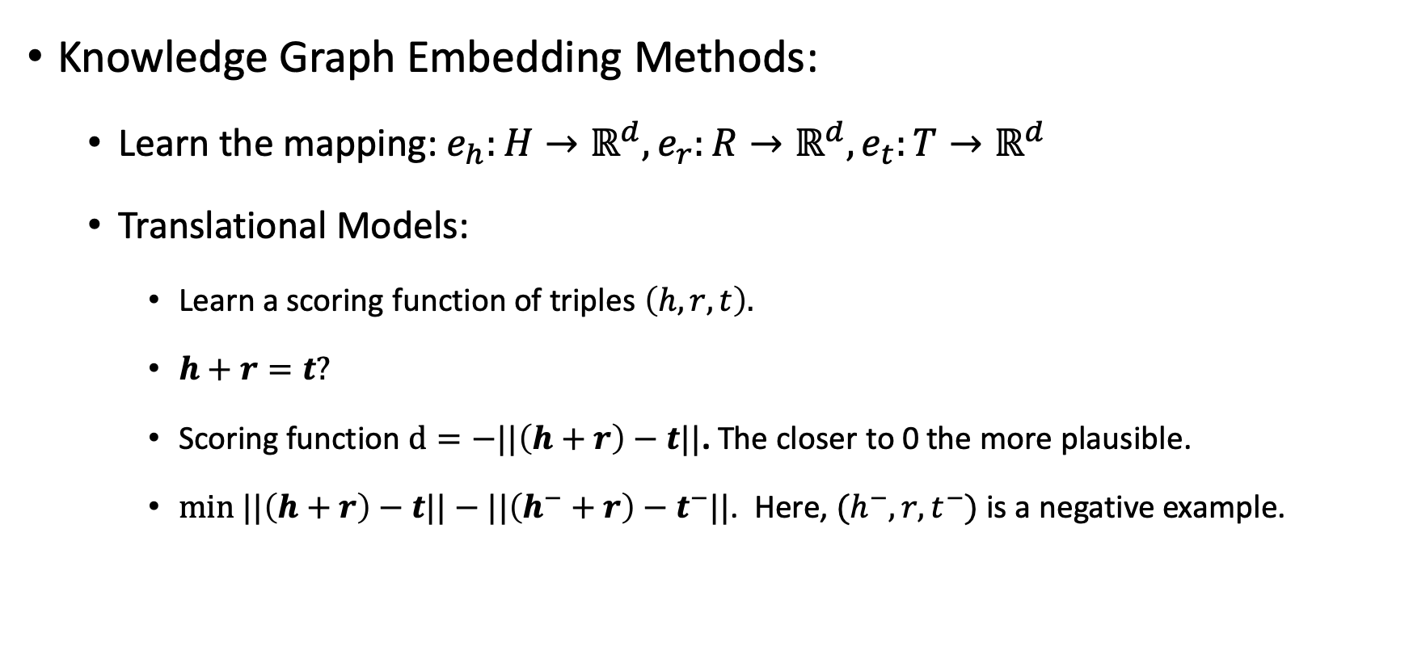
Methodologies
Knowledge Graph Embedding Methods:
Learn the mapping: $e_{h}:H→ℝ^{d}, e_{r}:R→ℝ^{d}, e_{t}:T→ℝ^{d}$
Translational Models:
Learn a scoring function of triples $\left(h, r, t\right).$
$h+r=t?$
Scoring function $d=−||\left(h+r\right)−t||$. The closer to 0 the more plausible.
$min ||\left(h+r\right)−t||−||\left(h^{−}+r\right)−t^{−}||$. Here, $(h^{−},r,t^{−})$ is a negative example.

Slide 9
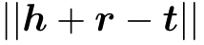
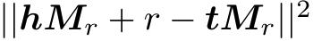
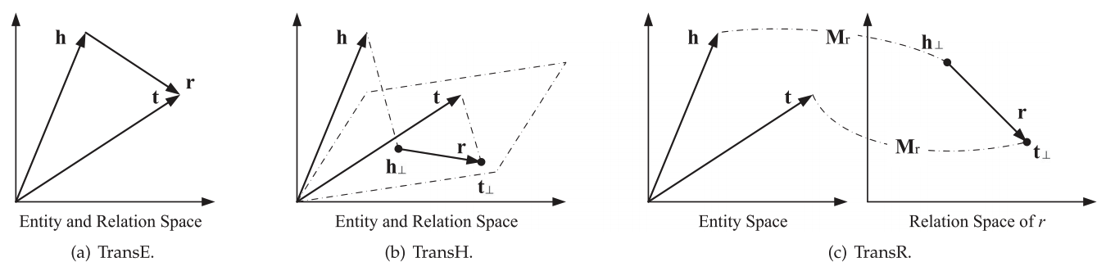
Methodologies
Scoring Functions of Knowledge Graph Embedding Methods:
In Euclidian space:
TransE:
TransH:
TransR:
Wang, Quan, et al. "Knowledge graph embedding: A survey of approaches and applications." IEEE Transactions on Knowledge and Data Engineering 29.12 (2017): 2724-2743.

Slide 10
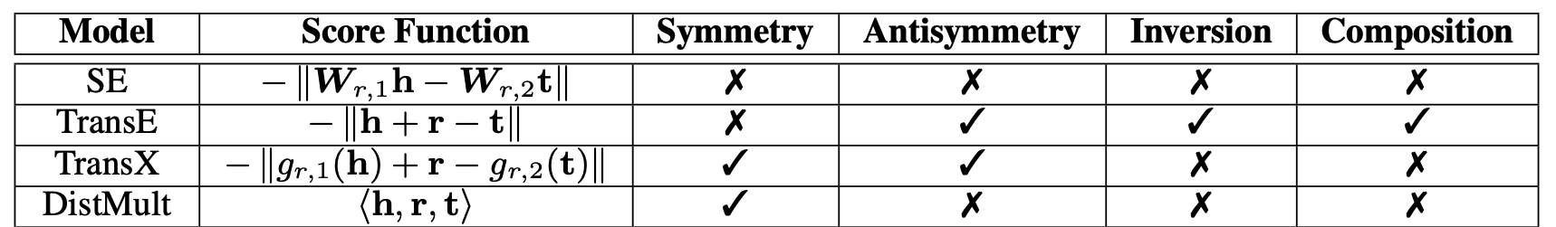
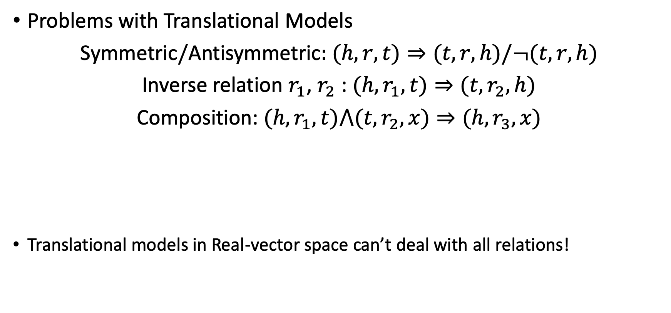
Methodologies
Problems with Translational Models
Symmetric/Antisymmetric: $(h, r, t)⇒(t, r, h)/¬(t, r, h)$
Inverse relation $r_{1}$, $r_{2}$ : $(h, r_{1},t)⇒(t, r_{2},h)$
Composition: $(h, r_{1},t)⋀(t, r_{2},x)⇒(h, r_{3},x)$
Translational models in Real-vector space can’t deal with all relations!
Sun, Zhiqing, et al. "Rotate: Knowledge graph embedding by relational rotation in complex space." ICLR (2019).
Notes:
For TransE-like models, the signs are different for head and tail in the scoring function. So it cannot deal with symmetry relation
For DistMult, which is a dot of head, relation, and tail, it doesn’t satisfy antisymmetry as when head and tail got inversed the equation would yield the same value. So does inversion and composition.

Slide 11
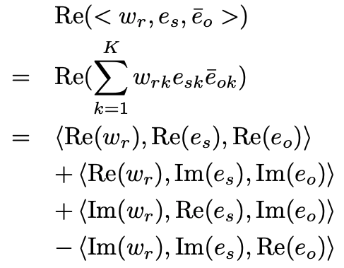
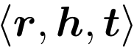
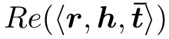
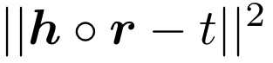
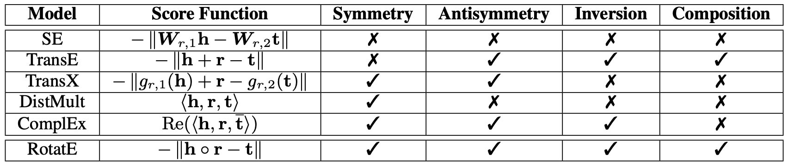
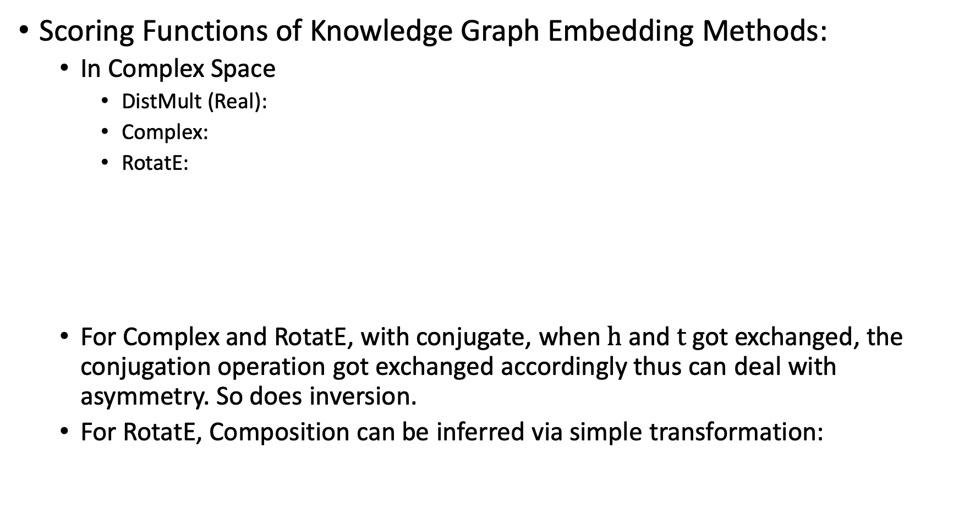
Methodologies
Scoring Functions of Knowledge Graph Embedding Methods:
In Complex Space
DistMult (Real):
Complex:
RotatE:
For Complex and RotatE, with conjugate, when $h$ and $t$ got exchanged, the conjugation operation got exchanged accordingly thus can deal with asymmetry. So does inversion.
For RotatE, Composition can be inferred via simple transformation:
Linear dot product
Hermitian dot product
Hadmard (or element-wise) product
Notes:
It is based on the idea of matrix factorization, SVD decomposition, etc.
Hermitian dot product

Slide 12
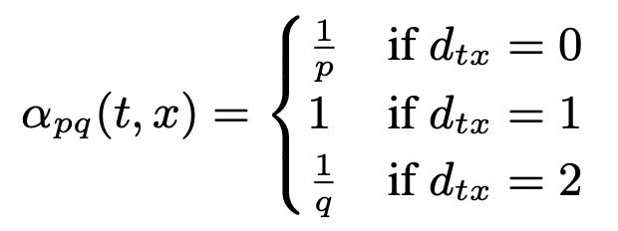
Methodologies
Node Classification
After embedding all the nodes, we would like to perform node classification to see whether nodes with the same types are clustered together.
We also compare KG embedding with random-walk based embedding methods, node2vec:
Grover, Aditya, and Jure Leskovec. "node2vec: Scalable feature learning for networks." Proceedings of the 22nd ACM SIGKDD international conference on Knowledge discovery and data mining. 2016.

Slide 13
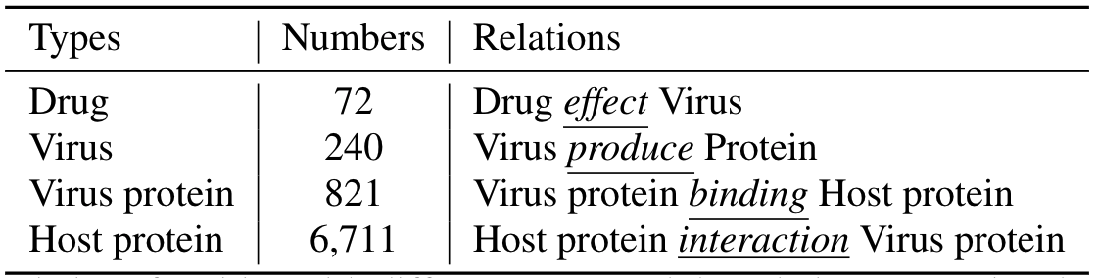
Experiments
Dataset
COVID-19 Related Virus-Protein-Drug Knowledge Graph.
Train/dev/test split is random with proportion 8:1:1, regarding edges.
Table: Definition and Statistics of the Dataset

Slide 14
Experiments
Evaluation metrics:
MR (Mean Rank)
Mean ranks of the correct answers.
MRR (Mean Reciprocal Rank)
Multiplicative inverse of the rank of the first correct answer: 1 for first place, 1⁄2 for second place, 1⁄3 for third place and so on.
HITS@k.
The proportion of correct answers in the top-k retrieved triples ranked by the model.

Slide 15
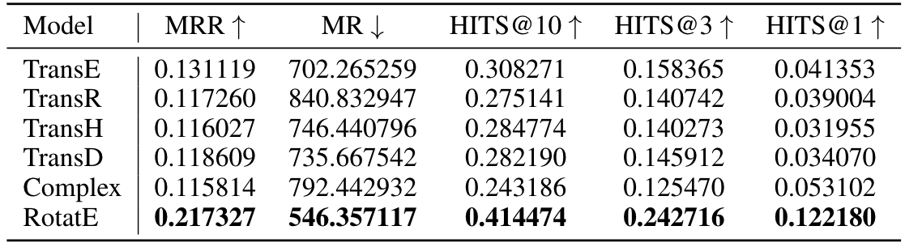
Results and Analysis
Link Prediction
We report the results under “filtered” setting, where links existing in the training set are filtered out.
RotatE performs the best among all 6 KG-embedding methods.

Slide 16
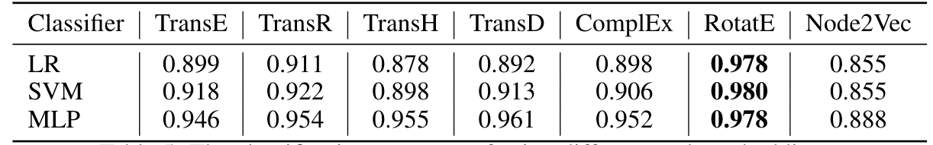
Results and Analysis
Node Classification
There are 4 types of nodes. We train classifiers to see the performance of distinguishing those 4 types of nodes.
RotatE is also the one where certain types of nodes are fully separated.

Slide 17
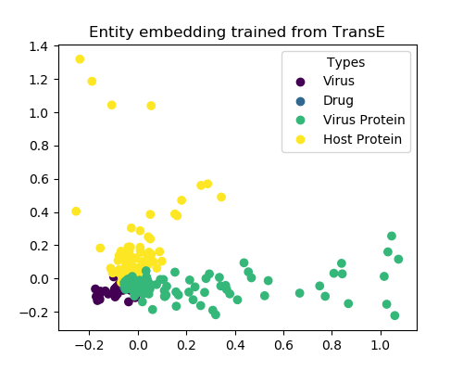
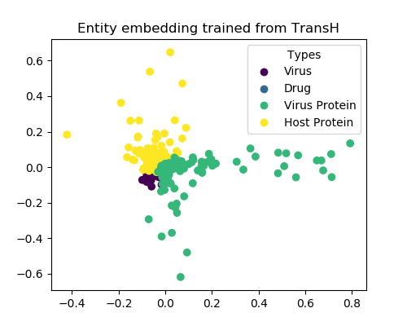
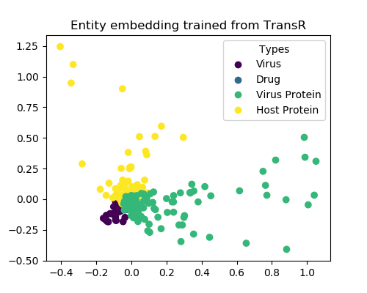
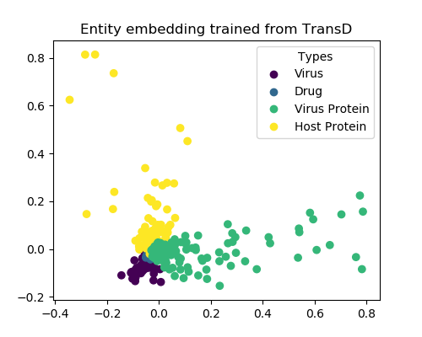
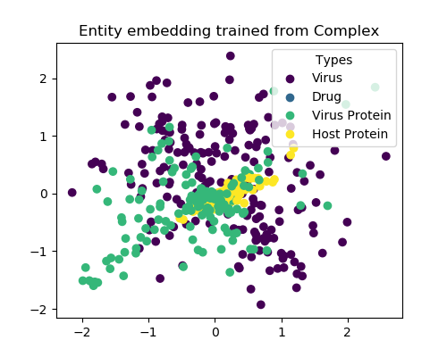
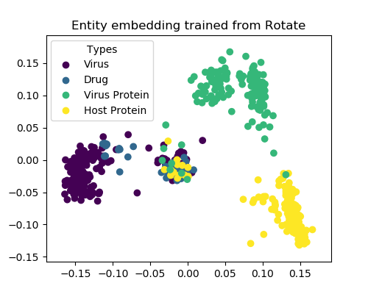
Results and Analysis
Visualization of Nodes (PCA)
Trans-based models share similar embedding clusters of different types of nodes
TransE
TransH
TransR
RotatE learns the topological structures the best, due to its compatability to different relation translation rules.
TransD
Complex
RotatE

Slide 18
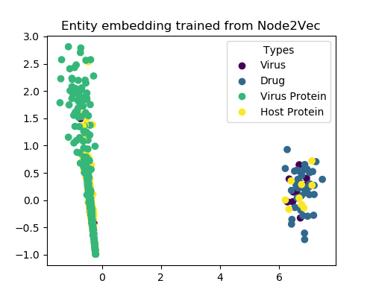
Results and Analysis
Visualization of Nodes (PCA)
Node2vec can hardly distinguish host/virus proteins as no relational information is taken into account.
RotatE
Node2vec

Slide 19
Conclusion
For COVID-19 Knowledge Graph Prediction, RotatE performs the best as it can encode all 3 frequent relational patterns.
Visualization and Node classification results also demonstrates the superiority of RotatE regarding different node types.
Random-walk-based methods is not suitable for the task as relational information is ignored.

